Slide 1
ArmNN SDK Compile on SP7021
Hugo Yu
2020/09/03

Slide 2
Before Building ArmNN
Set swap virtual memory as 2GB:
$ swapon -s Filename Type Size Used Priority /var/swap file 102396 0 -2
$ sudo vi /etc/dphys-swapfile #CONF_SWAPSIZE=100 (default is 100MB) CONF_SWAPSIZE=2048
$ sudo service dphys-swapfile restart
$ swapon -s Filename Type Size Used Priority /var/swap file 2097148 0 -2

Slide 3
Compile ArmNN
Working environment:
SP7021 with 32G SD card of 2020-05-27-raspios-buster-full-armhf
Refer to the following guide to compile ArmNN including Tensorflow, Tensorflow-Lite and ONNX parsers in the SP7021 with 2020-05-27-raspios-buster-full-armhf:
https://developer.arm.com/solutions/machine-learning-on-arm/developer-material/how-to-guides/cross-compiling-arm-nn-for-the-raspberry-pi-and-tensorflow/single-page

Slide 4
Before you begin
To install the tools you require, open a command window and enter the following commands:
$ sudo apt-get install git (1:2.20.1-2+deb10u3)
$ sudo apt-get install scons (3.0.1-2)
$ sudo apt-get install gcc-arm-linux-gnueabihf (4:8.3.0-1+rpi2)
$ sudo apt-get install g++-arm-linux-gnueabihf (4:8.3.0-1+rpi2)
$ sudo apt-get install curl (7.64.0-4+deb10u1)
$ sudo apt-get install autoconf (2.69-11)
$ sudo apt-get install libtool (2.4.6-9)
$ sudo apt-get install cmake (3.13.4-1)

Slide 5
Downloading the repositories and bundles
To create a directory and build your distribution:
$ mkdir armnn-pi && cd armnn-pi
$ export BASEDIR=`pwd`
Download the Compute Library, Boost, Protobuf, TensorFlow, ONNX, FlatBuffer, and Arm NN git repositories and source bundles:
$ git clone https://github.com/Arm-software/ComputeLibrary.git
$ git clone https://github.com/Arm-software/armnn.git
$ curl -L -o boost_1_64_0.tar.bz2 https://dl.bintray.com/boostorg/release/1.64.0/source/boost_1_64_0.tar.bz2
$ tar xf boost_1_64_0.tar.bz2
$ git clone -b v3.5.0 https://github.com/google/protobuf.git
$ git clone https://github.com/tensorflow/tensorflow.git
$ cd tensorflow/
$ git checkout 590d6eef7e91a6a7392c8ffffb7b58f2e0c8bc6b
$ cd ..
$ git clone https://github.com/onnx/onnx.git
$ cd onnx
$ git fetch https://github.com/onnx/onnx.git f612532843bd8e24efeab2815e45b436479cc9ab && git checkout FETCH_HEAD
$ cd ..
$ curl -L -o flatbuffers-1.10.0.tar.gz https://github.com/google/flatbuffers/archive/v1.10.0.tar.gz
$ tar xf flatbuffers-1.10.0.tar.gz
Release 1.15.0 (released on 2019-01-19)

Slide 6
Building the Compute Library
To build the library, enter the following command:
$ cd $BASEDIR/ComputeLibrary
$ scons extra_cxx_flags="-fPIC" Werror=0 debug=0 asserts=0 neon=1 opencl=0 os=linux arch=armv7a examples=1
This action will take 457m43.418s.

Slide 7
Building the Boost library
To build the Boost library for SP7021:
Enter the following commands:
$ cd $BASEDIR/boost_1_64_0/tools/build
$ ./bootstrap.sh
$ ./b2 install --prefix=$BASEDIR/boost.build
$ export PATH=$BASEDIR/boost.build/bin:$PATH
Create a project-config.jam file:
$ cp $BASEDIR/boost_1_64_0/tools/build/example/user-config.jam $BASEDIR/boost_1_64_0/project-config.jam
Open the project-config.jam file in a text editor:
In the GCC Configuration section, add the following line: using gcc : arm : arm-linux-gnueabihf-g++ ;
Save the project-config.jam file in the $BASEDIR/boost_1_64_0/ directory.
To complete the build:
$ cd $BASEDIR/boost_1_64_0
$ b2 --build-dir=$BASEDIR/boost_1_64_0/build toolset=gcc-arm link=static cxxflags=-fPIC --with-filesystem --with-test --with-log --with-program_options install --prefix=$BASEDIR/boost
This action will take 62m16.934s.

Slide 8
Building the Google Protobuf library
To build the Google Protobuf library for SP7021:
$ cd $BASEDIR/protobuf
$ git submodule update --init --recursive
$ ./autogen.sh
$ ./configure --prefix=$BASEDIR/protobuf-host
$ make -j4
$ make install
This action will take 96m14.112s
Submodule path 'third_party/benchmark': checked out '360e66c1c4777c99402cf8cd535aa510fee16573'

Slide 9
Generating the TensorFlow Protobuf library
To generate the TensorFlow Protobuf library, enter the following command:
$ cd $BASEDIR/tensorflow
$ ../armnn/scripts/generate_tensorflow_protobuf.sh ../tensorflow-protobuf ../protobuf-host

Slide 10
Building ONNX
To build ONNX, enter the following commands:
$ cd $BASEDIR/onnx
$ export LD_LIBRARY_PATH=$BASEDIR/protobuf-host/lib:$LD_LIBRARY_PATH
$ $BASEDIR/protobuf-host/bin/protoc onnx/onnx.proto --proto_path=. --proto_path=$BASEDIR/protobuf-host/include --cpp_out $BASEDIR/onnx

Slide 11
Building FlatBuffers
To build FlatBuffers for SP7021, enter the following commands:
$ cd $BASEDIR/flatbuffers-1.10.0
$ rm -f CMakeCache.txt
$ rm -rf build
$ mkdir build && cd build
$ cmake .. -DFLATBUFFERS_BUILD_FLATC=1 -DCMAKE_INSTALL_PREFIX:PATH=$BASEDIR/flatbuffers
$ make –j4 all // This action will take 19m49.516s
$ make install

Slide 12
Build TensorFlow Lite
To build TensorFlow Lite, enter the following commands:
$ cd $BASEDIR
$ mkdir tflite
$ cd tflite
$ cp $BASEDIR/tensorflow/tensorflow/lite/schema/schema.fbs .
$ $BASEDIR/flatbuffers-1.10.0/build/flatc -c --gen-object-api --reflect-types --reflect-names schema.fbs

Slide 13
Installing Prerequisites for Caffe (Extra Item for PyArmNN)
$ sudo apt-get update
$ sudo apt-get install git (1:2.20.1-2+deb10u3)
$ sudo apt-get install libprotobuf-dev (3.6.1.3-2+rpi1) conflict with 3.5, don’t install
$ sudo apt-get install libleveldb-dev (1.20-2.1)
$ sudo apt-get install libsnappy-dev (1.1.7-1)
$ sudo apt-get install libopencv-dev (3.2.0+dfsg-6)
$ sudo apt-get install libhdf5-dev (1.10.4+repack-10)
$ sudo apt-get install protobuf-compiler (3.6.1.3-2+rpi1) conflict with 3.5, don’t install
$ sudo apt-get install --no-install-recommends libboost-all-dev (1.67.0)
$ sudo apt-get install libatlas-base-dev (3.10.3-8+rpi1)
$ sudo apt-get install python-dev (2.7.16-1)
$ sudo apt-get install python3-dev (3.7.3-1)
$ sudo apt-get install libgflags-dev (2.2.2-1)
$ sudo apt-get install libgoogle-glog-dev (0.3.5-1)
$ sudo apt-get install liblmdb-dev (0.9.22-1)

Slide 14
Install Caffe with Python3.7 and OpenCV3.2 (Extra Item for PyArmNN)
Download Caffe:
$ cd $BASEDIR
$ git clone https://github.com/BVLC/caffe.git
Installation reference to http://caffe.berkeleyvision.org/installation.html
Compilation with Make:
$ cd caffe
$ cp Makefile.config.example Makefile.config
$ vi Makefile.config CPU_ONLY := 1 ← remove #
OPENCV_VERSION := 3 ← remove #
#PYTHON_INCLUDE := /usr/include/python2.7 \ ← add#
# /usr/lib/python2.7/dist-packages/numpy/core/include ← add#
PYTHON_LIBRARIES := boost_python37 python3.7m ← remove #
PYTHON_INCLUDE := /usr/include/python3.7m \ ← remove #
/usr/lib/python3/dist-packages/numpy/core/include ← remove # INCLUDE_DIRS := /home/adminuser/armnn-pi/protobuf-host/include $(PYTHON_INCLUDE) /usr/local/include /usr/include/hdf5/serial LIBRARY_DIRS := /home/adminuser/armnn-pi/protobuf-host/lib $(PYTHON_LIB) /usr/local/lib /usr/lib /usr/lib/arm-linux-gnueabihf /usr/lib/arm-linux-gnueabihf/hdf5/serial
$ vi Makefile LIBRARIES += hdf5_serial_hl hdf5_serial $(Q)/home/adminuser/armnn-pi/protobuf-host/bin/protoc --proto_path=$(PTOTO_SRC_DIR) --cpp_out=$(PROTO_BUILD_DIR) $< $(Q)/home/adminuser/armnn-pi/protobuf-host/bin/protoc --proto_path=src --python_out=python $<
$ make -j4 all //This action will take 49m13.439s
$ make test //This action will take 135m15.145s
$ make runtest //This action will take 7m40.883s
All are "RUN OK" → PASSED

Slide 15
Building ArmNN
To build Arm NN:
$ cd $BASEDIR/armnn && mkdir build && cd build
$ cmake .. -DCMAKE_C_COMPILER_FLAGS=-fPIC \
-DCMAKE_CXX_FLAGS=-mfpu=neon \
-DARMCOMPUTE_ROOT=$BASEDIR/ComputeLibrary \
-DARMCOMPUTE_BUILD_DIR=$BASEDIR/ComputeLibrary/build \
-DBOOST_ROOT=$BASEDIR/boost \
-DFLATBUFFERS_ROOT=$BASEDIR/flatbuffers \
-DFLATC_DIR=$BASEDIR/flatbuffers-1.10.0/build \
-DPROTOBUF_ROOT=$BASEDIR/protobuf-host \
-DTF_GENERATED_SOURCES=$BASEDIR/tensorflow-protobuf \
-DBUILD_TF_PARSER=1 \
-DBUILD_ONNX_PARSER=1 \
-DONNX_GENERATED_SOURCES=$BASEDIR/onnx \
-DBUILD_TF_LITE_PARSER=1 \
-DTF_LITE_GENERATED_PATH=$BASEDIR/tflite \
-DBUILD_CAFFE_PARSER=1 \
-DCAFFE_GENERATED_SOURCES=$BASEDIR/caffe/build/src \
-DBUILD_ARMNN_SERIALIZER=1 \
-DBUILD_ARMNN_QUANTIZER=1 \ -DBUILD_TESTS=1 \
-DBUILD_UNIT_TESTS=1 \
-DARMCOMPUTENEON=1 \
-DARMNNREF=1
$ make –j4 // This action will take 792m30.173s

Slide 16
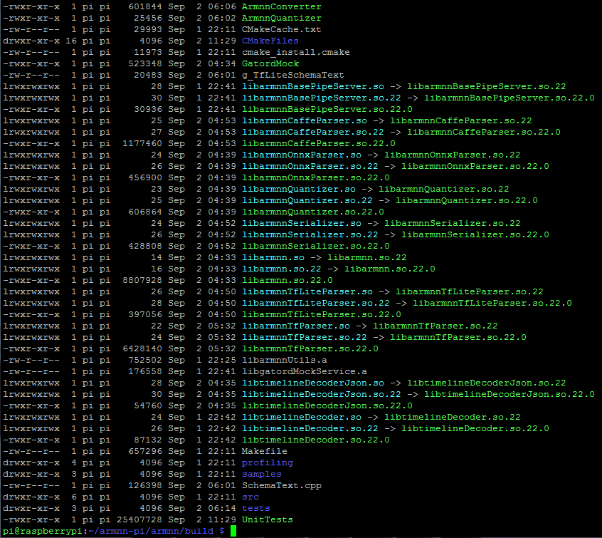
Building ArmNN
Files got after finish compile
ArmNN PATH:
Include path: $BASEDIR/armnn/include
Library path: $BASEDIR/armnn/build

Slide 17
Testing your build
To test that your build of Arm NN works correctly, run the Unit Tests. To run the Unit Tests, enter the following:
$ export LD_LIBRARY_PATH=$BASEDIR/armnn/build:$LD_LIBRARY_PATH
$ cd $BASEDIR/armnn/build
$ ./UnitTests //This action will take 1m24.038s
If the tests are successful, they output the following to the console:
*** No errors detected

Slide 18
Testing your build
To test that your build of Arm NN works correctly, run the Unit Tests. To run the Unit Tests, enter the following:
$ cd $BASEDIR/armnn/samples
$ export PATH=$BASEDIR/protobuf-host/bin:$PATH
$ g++ SimpleSample.cpp -I$BASEDIR/armnn/include -I$BASEDIR/boost/include -I$BASEDIR/protobuf-host/include -L$BASEDIR/armnn/build -L$BASEDIR/protobuf-host/lib -larmnn -larmnnTfParser -lprotobuf -o SimpleSample
$ g++ DynamicSample.cpp -I$BASEDIR/armnn/include -I$BASEDIR/boost/include -I$BASEDIR/protobuf-host/include -L$BASEDIR/armnn/build -L$BASEDIR/protobuf-host/lib -larmnn -larmnnTfParser -lprotobuf -o DynamicSample
$ export LD_LIBRARY_PATH=$BASEDIR/protobuf-host/lib:$LD_LIBRARY_PATH
$ ./SimpleSample →ok
$ ./DynamicSample →Error: Failed to optimise the input network.

Slide 19
Building PyArmNN
Install SWIG 4.x by following the guide on SWIG GitHub:
~/armnn-pi $ sudo apt-get install byacc -y (20140715-1)
~/armnn-pi $ sudo apt-get install libpcre3 libpcre3-dev (2:8.39-12)
~/armnn-pi $ git clone https://github.com/swig/swig.git
~/armnn-pi $ cd swig/
~/armnn-pi/swig $ ./autogen.sh
~/armnn-pi/swig $ ./configure
~/armnn-pi/swig $ make –j4 //This action will take 6m7.681s
~/armnn-pi/swig $ sudo make install
Install Python3 Wheel
$ sudo pip3 install --upgrade pip (pip-20.2.2)
$ sudo pip3 install wheel (0.32.3)

Slide 20
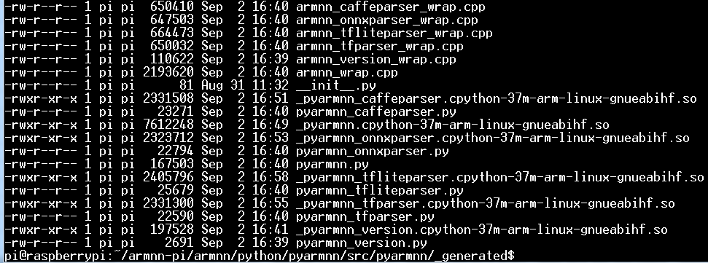
Building PyArmNN (Standalone build)
Set environment:
$ export SWIG_EXECUTABLE=/usr/local/bin/swig
$ export ARMNN_INCLUDE=$BASEDIR/armnn/include
$ export ARMNN_LIB=$BASEDIR/armnn/build
Clean and build SWIG wrappers:
$ cd $BASEDIR/armnn/python/pyarmnn
$ python3 setup.py clean --all
$ python3 swig_generate.py -v
$ python3 setup.py build_ext –inplace //This action will take 16m37.884s
This step will put all generated files under $BASEDIR/armnn/python/pyarmnn/src/pyarmnn/_generated folder and can be used repeatedly to re-generate the wrappers.
Build the source package and binary package
$ python3 setup.py sdist
As the result you will get $BASEDIR/armnn/python/pyarmnn/dist/dist/pyarmnn-22.0.0.tar.gz file. As you can see it is platform independent.
$ python3 setup.py bdist_wheel
As the result you will get $BASEDIR/armnn/python/pyarmnn/dist/pyarmnn-22.0.0-cp37-cp37m-linux_armv7l.whl file. As you can see it is platform dependent.

Slide 21
Building PyArmNN (Standalone build)
Build the source package and binary package
$ python3 setup.py sdist
As the result you will get $BASEDIR/armnn/python/pyarmnn/dist/dist/pyarmnn-22.0.0.tar.gz file. As you can see it is platform independent.
$ python3 setup.py bdist_wheel
As the result you will get $BASEDIR/armnn/python/pyarmnn/dist/pyarmnn-22.0.0-cp37-cp37m-linux_armv7l.whl file. As you can see it is platform dependent.

Slide 22
Installing PyArmNN
Installing PyArmNN from binary package:
$ export ARMNN_LIB=$BASEDIR/armnn/build $ export ARMNN_INCLUDE=$BASEDIR/armnn/include $ sudo pip3 install $BASEDIR/armnn/python/pyarmnn/dist/pyarmnn-22.0.0-cp37-cp37m-linux_armv7l.whl … Successfully installed pyarmnn-22.0.0
Verify PyArmNN by running the following:
$ pip3 show pyarmnn
Name: pyarmnn
Version: 22.0.0
Summary: Python bindings for Arm NN
Home-page: https://mlplatform.org/
Author: Arm Ltd, NXP Semiconductors
Author-email: support@linaro.org
License: MIT
Location: /usr/local/lib/python3.7/dist-packages
Requires: numpy
Required-by:
$ python3 -c "import pyarmnn as ann;print(ann.GetVersion())”
'22.0.0'

Slide 23
Installing PyArmNN
Installing PyArmNN from source package:
$ export ARMNN_LIB=$BASEDIR/armnn/build $ export ARMNN_INCLUDE=$BASEDIR/armnn/include $ sudo pip3 install $BASEDIR/armnn/python/pyarmnn/dist/pyarmnn-22.0.0.tar.gz

Slide 24
PyArmNN Unit Test
Running unit-tests:
$ cd ~/armnn-pi/armnn/python/pyarmnn/scripts
$ python3 ./download_test_resources.py
The script will download an archive from the Linaro server and extract it. A folder test/testdata/shared will be created. Execute pytest from the project root dir:
$ cd ~/armnn-pi/armnn/python/pyarmnn
$ sudo pip3 install pytest
$ sudo python3 -m pytest test/ -v
test/test_network.py::test_optimize_executes_successfully_for_neon_backend_only[mock_model] SKIPPED [ 68%]
test/test_network.py::test_serialize_to_dot_mode_readonly[mock_model] SKIPPED [ 68%]
test/test_runtime.py::test_multiple_inference_runs_yield_same_result[5] SKIPPED [ 86%]
test/test_runtime.py::test_aarch64_inference_results SKIPPED [ 86%]
test/test_supported_backends.py::TestNoneCpuRefBackends::test_get_supported_backends_cpu_acc[CpuAcc] SKIPPED [ 89%]] SKIPPED [ 89%]

Slide 25
PyArmNN Example
tflite_mobilenetv1_quantized:
$ cd ~/armnn-pi/armnn/python/pyarmnn/examples
$ pip3 install -r ./requirements.txt
$ sudo python3 tflite_mobilenetv1_quantized.py

Slide 26
PyArmNN Example
onnx_mobilenetv2:
$ sudo python3 onnx_mobilenetv2.py

Slide 27
Others Notes
Environment Variable setting during all process.
$ export BASEDIR=~/armnn-pi
$ export PATH=$BASEDIR/boost.build/bin:$PATH
$ export PATH=$BASEDIR/protobuf-host/bin:$PATH
$ export LD_LIBRARY_PATH=$BASEDIR/protobuf-host/lib:$LD_LIBRARY_PATH
$ export LD_LIBRARY_PATH=$BASEDIR/armnn/build:$LD_LIBRARY_PATH
$ export ARMNN_INCLUDE=$BASEDIR/armnn/include
$ export ARMNN_LIB=$BASEDIR/armnn/build
Build action cost time:
Compute Library 457m43.418s
Boost library 62m16.934s
Google Protobuf library 96m14.112s
FlatBuffers 19m49.516s
Caffe 49m13.439s
Caffe make test 135m15.145s
caffe make runtest 7m40.883s
ArmNN SDK 792m30.173s
ArmNN SDK UnitTest 1m24.038s
SWIG 4.1 6m7.681s
PyArmNN SWIG wrappers 16m37.884s

Slide 28
Others Notes
Install ArmNN SDK and PyArmNN to another SP7021 with RPI_OS
Copy $BASEDIR/armnn and $BASEDIR/protobuf-host to another SP7021
Set Environment Variable setting in another SP7021
$ export BASEDIR=~/armnn-pi
$ export PATH=$BASEDIR/protobuf-host/bin:$PATH
$ export LD_LIBRARY_PATH=$BASEDIR/protobuf-host/lib:$LD_LIBRARY_PATH
$ export LD_LIBRARY_PATH=$BASEDIR/armnn/build:$LD_LIBRARY_PATH
$ export ARMNN_INCLUDE=$BASEDIR/armnn/include
$ export ARMNN_LIB=$BASEDIR/armnn/build

