Slide 1
ArmNN SDK Cross Compile for SP7021
Hugo Yu
2020/08/26

Slide 2
Cross compile ArmNN
Working environment:
PC with Ubuntu 18.04LTS
Follow the following guide to cross compile ArmNN including Tensorflow, Tensorflow-Lite and ONNX parsers in the PC with Ubuntu 18.04LTS:
https://developer.arm.com/solutions/machine-learning-on-arm/developer-material/how-to-guides/cross-compiling-arm-nn-for-the-raspberry-pi-and-tensorflow/single-page

Slide 3
Before you begin
To install the tools you require, open a command window and enter the following commands:
$ sudo apt-get install git
$ sudo apt-get install scons
$ sudo apt-get install gcc-arm-linux-gnueabihf
$ sudo apt-get install g++-arm-linux-gnueabihf
$ sudo apt-get install curl
$ sudo apt-get install autoconf
$ sudo apt-get install libtool
$ sudo apt-get install cmake

Slide 4
Downloading the repositories and bundles
To create a directory and build your distribution:
$ mkdir armnn-pi && cd armnn-pi
$ export BASEDIR=`pwd`
Download the Compute Library, Boost, Protobuf, TensorFlow, ONNX, FlatBuffer, and Arm NN git repositories and source bundles:
$ git clone https://github.com/Arm-software/ComputeLibrary.git
$ git clone https://github.com/Arm-software/armnn.git
$ wget https://dl.bintray.com/boostorg/release/1.64.0/source/boost_1_64_0.tar.bz2
$ tar xf boost_1_64_0.tar.bz2
$ git clone -b v3.5.0 https://github.com/google/protobuf.git
$ git clone https://github.com/tensorflow/tensorflow.git
$ cd tensorflow/
$ git checkout 590d6eef7e91a6a7392c8ffffb7b58f2e0c8bc6b
$ cd ..
$ git clone https://github.com/onnx/onnx.git
$ cd onnx
$ git fetch https://github.com/onnx/onnx.git f612532843bd8e24efeab2815e45b436479cc9ab && git checkout FETCH_HEAD
$ cd ..
$ wget -O flatbuffers-1.10.0.tar.gz https://github.com/google/flatbuffers/archive/v1.10.0.tar.gz
$ tar xf flatbuffers-1.10.0.tar.gz
Release 1.15.0 (released on 2019-01-19)

Slide 5
Building the Compute Library
To build the library, enter the following command:
$ cd $BASEDIR/ComputeLibrary
$ scons extra_cxx_flags="-fPIC" Werror=0 debug=0 asserts=0 neon=1 opencl=0 os=linux arch=armv7a examples=1
This action will take 15-20 minutes.

Slide 6
Building the Boost library
To build the Boost library for SP7021:
Enter the following commands:
$ cd $BASEDIR/boost_1_64_0/tools/build
$ ./bootstrap.sh
$ ./b2 install --prefix=$BASEDIR/boost.build
$ export PATH=$BASEDIR/boost.build/bin:$PATH
Create a project-config.jam file:
$ cp $BASEDIR/boost_1_64_0/tools/build/example/user-config.jam $BASEDIR/boost_1_64_0/project-config.jam
Open the project-config.jam file in a text editor:
In the GCC Configuration section, add the following line: using gcc : arm : arm-linux-gnueabihf-g++ ;
Save the project-config.jam file in the $BASEDIR/boost_1_64_0/ directory.
To complete the build:
$ cd $BASEDIR/boost_1_64_0
$ b2 --build-dir=$BASEDIR/boost_1_64_0/build toolset=gcc-arm link=static cxxflags=-fPIC --with-filesystem --with-test --with-log --with-program_options install --prefix=$BASEDIR/boost
This action will take 15-20 minutes.

Slide 7
Building the Google Protobuf library
To build the Google Protobuf library for your PC:
$ cd $BASEDIR/protobuf
$ git submodule update --init --recursive
$ ./autogen.sh
$ ./configure --prefix=$BASEDIR/protobuf-host
$ make
$ make install
$ make clean
To build the Google Protobuf library for SP7021:
$ ./configure --prefix=$BASEDIR/protobuf-arm --host=arm-linux CC=arm-linux-gnueabihf-gcc CXX=arm-linux-gnueabihf-g++ --with-protoc=$BASEDIR/protobuf-host/bin/protoc
$ make
$ make install
This action will take 15-20 minutes.

Slide 8
Generating the TensorFlow Protobuf library
To generate the TensorFlow Protobuf library, enter the following command:
$ cd $BASEDIR/tensorflow
$ ../armnn/scripts/generate_tensorflow_protobuf.sh ../tensorflow-protobuf ../protobuf-host

Slide 9
Building ONNX
To build ONNX, enter the following commands:
$ cd $BASEDIR/onnx
$ export LD_LIBRARY_PATH=$BASEDIR/protobuf-host/lib:$LD_LIBRARY_PATH
$ $BASEDIR/protobuf-host/bin/protoc onnx/onnx.proto --proto_path=. --proto_path=$BASEDIR/protobuf-host/include --cpp_out $BASEDIR/onnx

Slide 10
Building FlatBuffers
To build FlatBuffers for your PC, enter the following commands:
$ cd $BASEDIR/flatbuffers-1.10.0
$ rm -f CMakeCache.txt
$ rm -rf build
$ mkdir build && cd build
$ cmake .. -DFLATBUFFERS_BUILD_FLATC=1 -DCMAKE_INSTALL_PREFIX:PATH=$BASEDIR/flatbuffers
$ make all install
To build FlatBuffers for SP7021, enter the following commands:
$ cd $BASEDIR/flatbuffers-1.10.0
$ mkdir build-arm32 && cd build-arm32
$ cmake .. -DCMAKE_C_COMPILER=/usr/bin/arm-linux-gnueabihf-gcc \ -DCMAKE_CXX_COMPILER=/usr/bin/arm-linux-gnueabihf-g++ \ -DFLATBUFFERS_BUILD_FLATC=1 \ -DCMAKE_INSTALL_PREFIX:PATH=$BASEDIR/flatbuffers-arm32 \ -DFLATBUFFERS_BUILD_TESTS=0

Slide 11
Build TensorFlow Lite
To build TensorFlow Lite, enter the following commands:
$ cd $BASEDIR
$ mkdir tflite
$ cd tflite
$ cp $BASEDIR/tensorflow/tensorflow/lite/schema/schema.fbs .
$ $BASEDIR/flatbuffers-1.10.0/build/flatc -c --gen-object-api --reflect-types --reflect-names schema.fbs

Slide 12
Installing Prerequisites for Caffe (Extra Item for PyArmNN)
$ sudo apt-get update
$ sudo apt-get install git
$ sudo apt-get install libprotobuf-dev
$ sudo apt-get install libleveldb-dev
$ sudo apt-get install libsnappy-dev
$ sudo apt-get install libopencv-dev
$ sudo apt-get install libhdf5-serial-dev
$ sudo apt-get install protobuf-compiler
$ sudo apt-get install --no-install-recommends libboost-all-dev
$ sudo apt-get install libatlas-base-dev
$ sudo apt-get install python-dev
$ sudo apt-get install libgflags-dev
$ sudo apt-get install libgoogle-glog-dev
$ sudo apt-get install liblmdb-dev

Slide 13
Install Caffe (Extra Item for PyArmNN)
Download Caffe:
$ cd $BASEDIR
$ git clone https://github.com/BVLC/caffe.git
Installation reference to http://caffe.berkeleyvision.org/installation.html
Compilation with Make:
$ cd caffe
$ cp Makefile.config.example Makefile.config
$ vi Makefile.config CPU_ONLY := 1 ← remove # INCLUDE_DIRS := /home/adminuser/armnn-pi/protobuf-host/include $(PYTHON_INCLUDE) /usr/local/include /usr/include/hdf5/serial LIBRARY_DIRS := /home/adminuser/armnn-pi/protobuf-host/lib $(PYTHON_LIB) /usr/local/lib usr/lib
$ vi Makefile LIBRARIES += hdf5_serial_hl hdf5_serial $(Q)/home/adminuser/armnn-pi/protobuf-host/bin/protoc --proto_path=$(PTOTO_SRC_DIR) --cpp_out=$(PROTO_BUILD_DIR) $< $(Q)/home/adminuser/armnn-pi/protobuf-host/bin/protoc --proto_path=src --python_out=python $<
$ make all
$ make test
$ make runtest
All are "RUN OK" → PASSED

Slide 14
Building ArmNN
To build Arm NN:
$ cd $BASEDIR/armnn && mkdir build && cd build
cmake .. -DCMAKE_LINKER=/usr/bin/arm-linux-gnueabihf-ld \
-DCMAKE_C_COMPILER=/usr/bin/arm-linux-gnueabihf-gcc \
-DCMAKE_CXX_COMPILER=/usr/bin/arm-linux-gnueabihf-g++ \
-DCMAKE_C_COMPILER_FLAGS=-fPIC \
-DCMAKE_CXX_FLAGS=-mfpu=neon \
-DARMCOMPUTE_ROOT=$BASEDIR/ComputeLibrary \
-DARMCOMPUTE_BUILD_DIR=$BASEDIR/ComputeLibrary/build \
-DBOOST_ROOT=$BASEDIR/boost \
-DTF_GENERATED_SOURCES=$BASEDIR/tensorflow-protobuf \
-DBUILD_TF_PARSER=1 \
-DBUILD_ONNX_PARSER=1 \
-DONNX_GENERATED_SOURCES=$BASEDIR/onnx \
-DBUILD_TF_LITE_PARSER=1 \
-DTF_LITE_GENERATED_PATH=$BASEDIR/tflite \
-DBUILD_CAFFE_PARSER=1 \
-DCAFFE_GENERATED_SOURCES=$BASEDIR/caffe/build/src \
-DFLATBUFFERS_ROOT=$BASEDIR/flatbuffers-arm32 \
-DFLATC_DIR=$BASEDIR/flatbuffers-1.10.0/build \
-DPROTOBUF_ROOT=$BASEDIR/protobuf-arm \
-DBUILD_ARMNN_SERIALIZER=1 \
-DBUILD_ARMNN_QUANTIZER=1 \ -DBUILD_TESTS=1 \
-DBUILD_UNIT_TESTS=1 \
-DARMCOMPUTENEON=1 \
-DARMNNREF=1
$ make

Slide 15
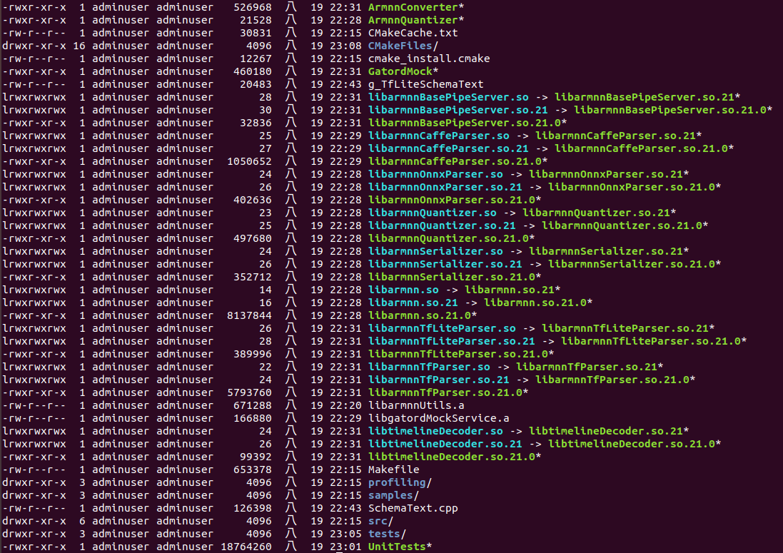
Building ArmNN
Files got after finish compile
ArmNN PATH:
Include path: $BASEDIR/armnn/include
Library path: $BASEDIR/armnn/build

Slide 16
Packet ArmNN SDK for SP7021
Packet the following libraries, binaries, and directories
$ mkdir armnn-dist && mkdir armnn-dist/armnn
cp -r $BASEDIR/armnn/include $BASEDIR/armnn-dist/armnn/include
cp -r $BASEDIR/armnn/build $BASEDIR/armnn-dist/armnn/
cp -r $BASEDIR/boost $BASEDIR/armnn-dist/boost

