Slide 1
ArmNN and TensorFlow base mnist-draw
Smart Computing Program 2020/8/26

Slide 2
Outline
Download mnist-draw source code, armnn and tensorflow library
Extract armnn and tensorflow library
Launch Python server
Execute example

Slide 3
Download mnist-draw source code, armnn and tensorflow library
下載已經編譯好的code與相關的SDK
git clone https://github.com/sunplus-plus1/armnn_test.git

Slide 4
Extract armnn and tensorflow library
將下載來的檔案解壓縮
cd armnn_test
tar -xzf armnn-dist.tar.gz

Slide 5
Launch Python server
設定armnn SDK library link path
cd mnist-draw
export LD_LIBRARY_PATH=/home/pi/armnn_test/armnn-dist/armnn/lib
啟動python server
python3 -m http.server --cgi 8000

Slide 6
Execute example
開啟瀏覽器去連上python server進行操作
如SP7021已連上網路有獨立IP, 在瀏覽器輸入下列內容以進行連接
http://172.18.12.122:8000
如SP7021無連上網路, 請開啟RPI_OS本身的瀏覽器,輸入下列內容以進行連接
http://127.0.0.1:8000

Slide 7
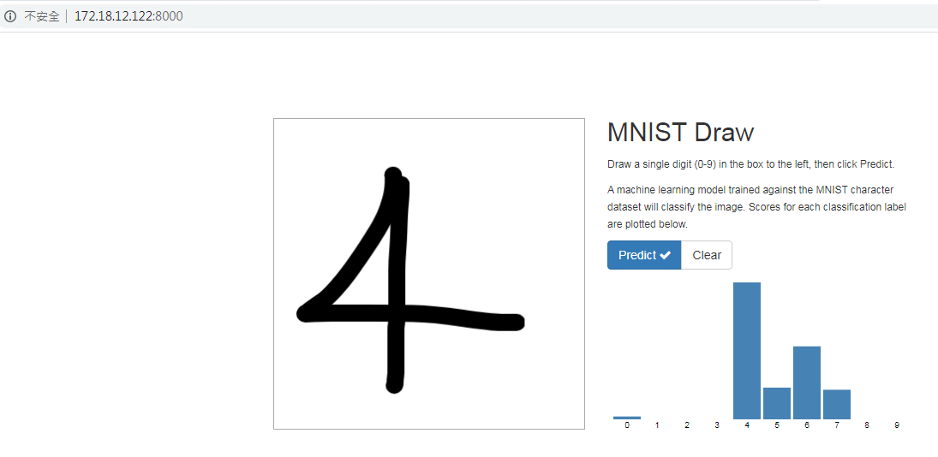
Execute example
3. 連線網頁操作
使用滑鼠在方框中寫一個阿拉伯數字, 然後滑鼠點擊Predict, 接下來就會進行辨識並列出TOP 5結果的機率柱狀圖.
如要進行下一輪辨識, 滑鼠點擊Clear, 再重新操作即可.

