Slide 1
FaceTracking WebCam example on SP7021
Smart Computing Program 2020/8/26

Slide 2
Outline
Enable the PWM driver
Configure the output pin of pwm in dts
Hardware circuit connection
PWM test
Compile source code for SD card boot and copy the files for booting from rpi-os.
Install related components
Download ncnn source code
Download the example code
Compile the example code
Execute example code
PWM using method in code(c++)
Other notes
Result

Slide 3
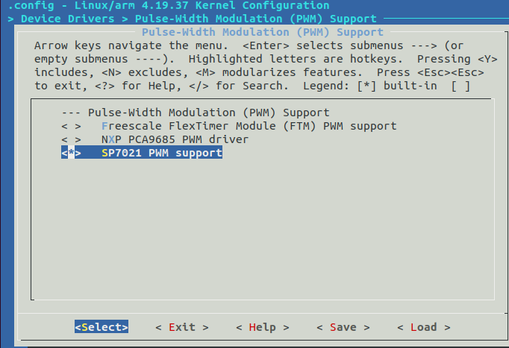
Enable the PWM driver
1. Go to code/linux/kernel/ and type “make menuconfig”
2. Enable SP7021 PWM support.

Slide 4
Configure the output pin of pwm in dts
1. 編輯 code/linux/kernel/arch/arm/boot/dts/sp7021-demov3.dts
a. 把disable取消, pwm才能用.
b. 設定PWM0,1從pinmux的哪個pin輸出(8,9)
&pwm {
pinctrl-names = "default";
pinctrl-0 = <&pins_pwm>;
//status = "disabled";
};
pins_pwm:
pinmux_pins_pwm {
sppctl,pins = <
SPPCTL_IOPAD(8,SPPCTL_PCTL_G_PMUX,MUXF_PWM0,0)
SPPCTL_IOPAD(9,SPPCTL_PCTL_G_PMUX,MUXF_PWM1,0)
SPPCTL_IOPAD(38,SPPCTL_PCTL_G_PMUX,MUXF_PWM2,0)
SPPCTL_IOPAD(39,SPPCTL_PCTL_G_PMUX,MUXF_PWM3,0)
>;
};

Slide 5
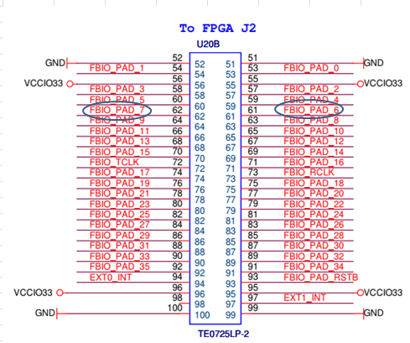
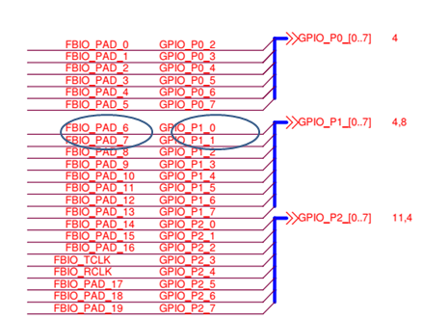
Hardware circuit connection
1. Pinmux與GPIO pin的關係及舵機馬達控制接線其在電路圖的
位置

Slide 6
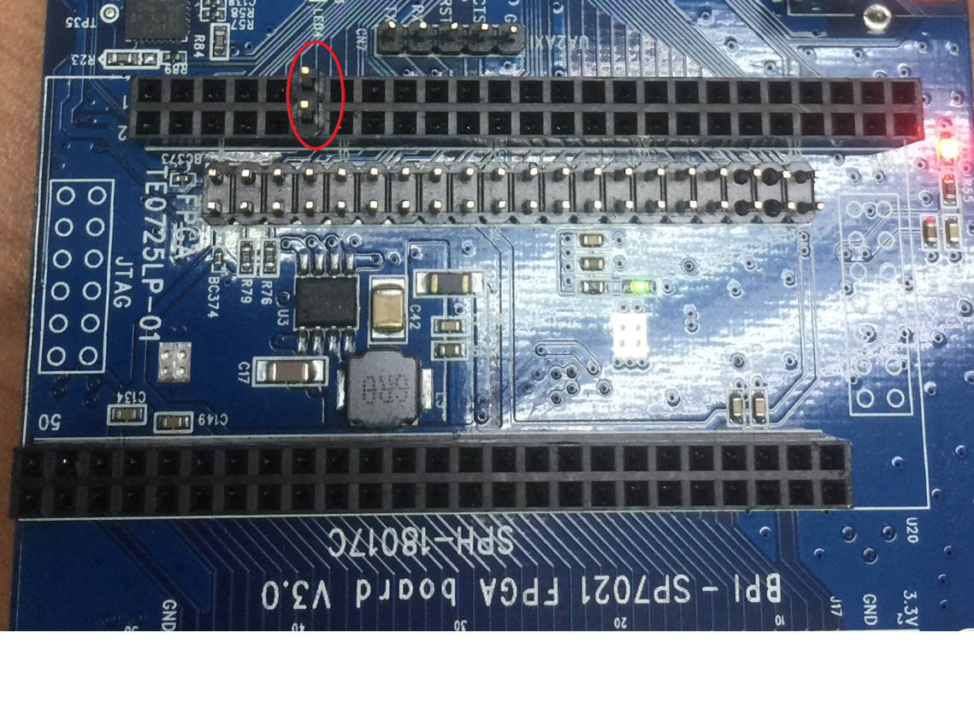
Hardware circuit connection
2. Pinmux 8, 9 在版子上的位置
pwm8 在上, pwm9在下

Slide 7
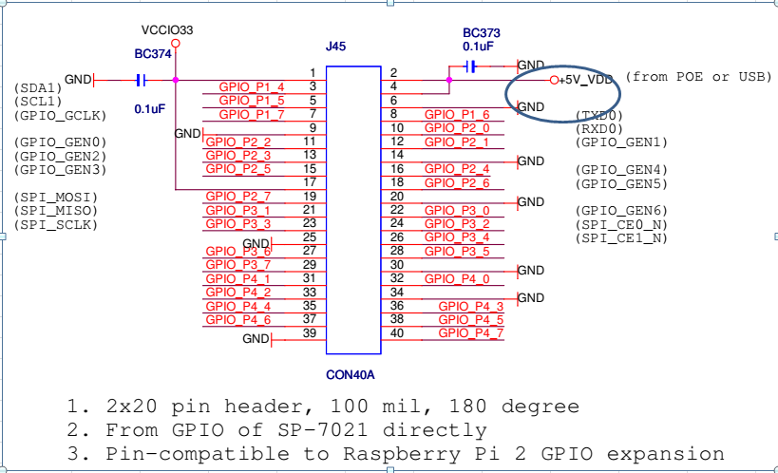
Hardware circuit connection
3. 舵機馬達電源接線在電路圖的位置

Slide 8
Hardware circuit connection
4. 舵機馬達電源接線在版子上的位置
左邊是5V, 右邊是GND

Slide 9
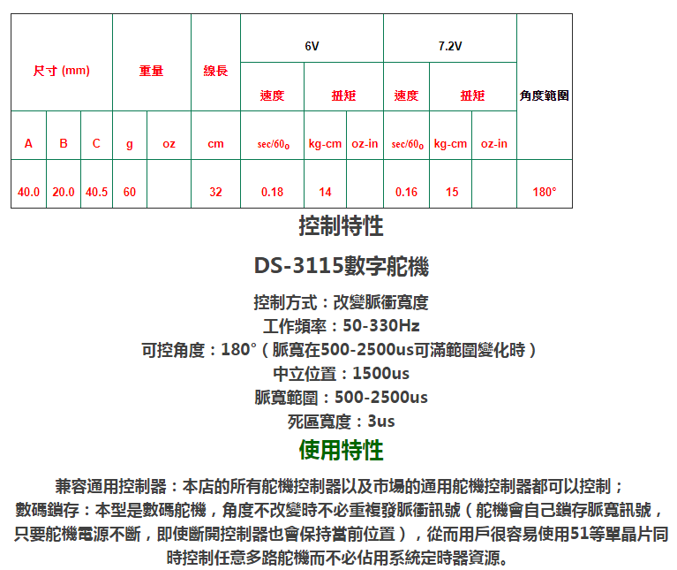
Hardware circuit connection
5. 舵機馬達SPEC

Slide 10
PWM test
1. 確認pwm driver有無正確掛上
cd /sys/class/pwm
ls
如果有看到pwmchip0這個link, 就表示driver有掛上.
2. 使用command掛上pwm0的device node並設定開啟使用
cd /sys/class/pwm/pwmchip0
sudo chmod 777 export
sudo echo 0 > export →開啟pwm0 device node
cd pwm0
sudo chmod 777 period
sudo chmod 777 duty_cycle
sudo chmod 777 enable
sudo echo 3030000 > period →pwm frequency ~= 330Hz (1000000000 / 3030000)
sudo echo 1500000 > duty_cycle →pwm pulse period = 1500us (1500000 / 1000)
sudo echo 1 > enable →enable pwm0

Slide 11
PWM test
3. 使用command掛上pwm1的device node並設定開啟使用
cd /sys/class/pwm/pwmchip0
sudo echo 1 > export →開啟pwm1 device node
cd pwm1
sudo chmod 777 period
sudo chmod 777 duty_cycle
sudo chmod 777 enable
sudo echo 3030000 > period →pwm frequency ~= 330Hz (1000000000 / 3030000)
sudo echo 1500000 > duty_cycle →pwm pulse period = 1500us (1500000 / 1000)
sudo echo 1 > enable →enable pwm1

Slide 12
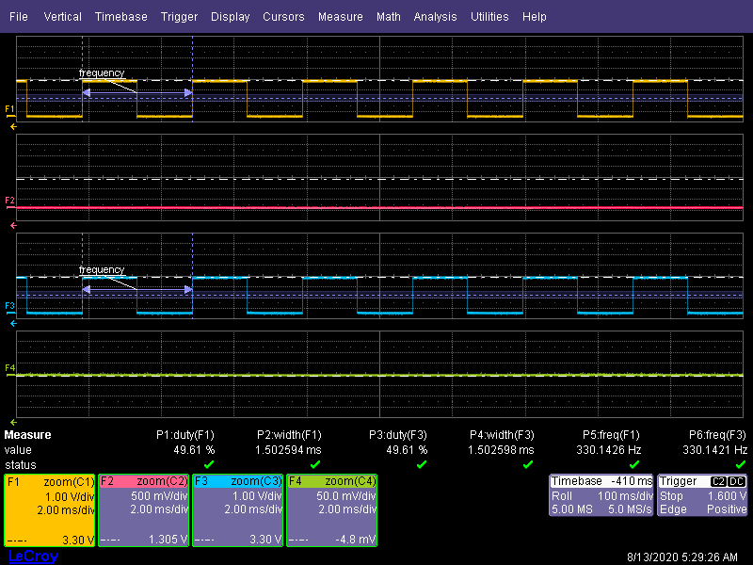
PWM test
4. 掛載完後pwm device node 後的檔案狀況
5. PWM 訊號

Slide 13
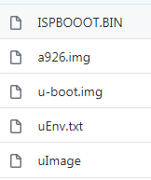
Compile source code for SD card boot and copy the files for booting from rpi-os.
1. 請參考底下網頁的操作說明:
https://sunplus-tibbo.atlassian.net/wiki/spaces/doc/pages/461045886/How+to+build+and+install+SP7021+Linux+image+to+run+Raspbian+on+SD+card
2. 或是從github下載開機檔, 再將5個開機檔拷貝進RPI_OS的SD卡的boot
partition的根目錄下 (只拷貝檔案, 不要把下載下來的目錄連檔案一起拷貝).
git clone https://github.com/HugoYu33/SP7021-SD-boot-pwm.git

Slide 14
Install related components
1. 使用先前置做好的RPI_OS SD卡開機進入RPI_OS中.
2. 安裝執行example所需要的套件: cmake, libopencv-dev
sudo apt install cmake libopencv-dev

Slide 15
Download ncnn source code
1. 從git hub上下載ncnn的source code
git clone --depth=1 https://github.com/tencent/ncnn.git
下載下來的code會放在ncnn的資料夾中

Slide 16
Download the example code
1. 從git hub上下載example code
git clone https://github.com/HugoYu33/ncnn-face-tracking.git
下載下來的code會放在ncnn-face-tracking的資料夾中
2. 將資料夾中的內容拷貝到ncnn/example/ 中
cp -rf ncnn-face-tracking/** ~/ncnn/examples/

Slide 17
Compile the example code
1. 進入~/ncnn/example/中, 並執行build開始編繹code
cd ~/ncnn/examples/
chmod +x build
./build
第一次編繹會花比較長的時間, 因為有opencv與ncnn的library需要編繹, 第二次後就比較快了, 如果只修改主要的example code: mtcnn_new.cpp.
編譯完的執行檔(mtcnn_new)會放在~/ncnn/examples/b/examples 下, 詳細檔案如下:

Slide 18
Execute example code
1. 進入~/ncnn/example/下去執行example code.
sudo ./b/example/mtcnn_new 0
先前編譯好的執行檔mtcnn_new是放在 ~/ncnn/example/b/example/ 下的, 但因為連結設定的關係, 需要在~/ncnn/example/ 下去執行才會沒問題.

Slide 19
Execute example code
2. mtcnn_new 的執行參數介紹: 按順序描述.
camera_id: v4L2 video device, the usb camera in the
raspberry is video 0.
Model selection: 1→using sunplus optimized model data,
0→using default model.
process point: if >=1 it will show character point in the face
KP_X, KI_X, KD_X, KP_Y, KI_Y, KD_Y (default value: 3, 0.1, 0.5, 2, 0.1, 0.5)
DEAD_ZONE_X, DEAD_ZONE_ (default value: 0.1, 0.1)

Slide 20
PWM using method in code(c++)
/** open pwm0****/
ofstream ofile("/sys/class/pwm/pwmchip0/export",ios::out);
ofile<<0<<endl;
ofile.close();
/**** pwm0 period set ****/
ofstream ofile0_period("/sys/class/pwm/pwmchip0/pwm0/period",ios::out);
if(!ofile0_period) {
printf(" open ofile0_period failed \n");
exit(1);
}
ofile0_period<<PWM_CYCLE<<endl;
ofile0_period.close();

Slide 21
PWM using method in code(c++)
/**** pwm0 duty set ****/
ofstream ofile0_duty("/sys/class/pwm/pwmchip0/pwm0/duty_cycle",ios::out);
if(!ofile0_duty) {
printf(" open ofile0_duty\n");
exit(1);
}
ofile0_duty<<(MOTOR_CENTER_PERIOD)<<endl;//for motor, 1500us period is in the center position
/**** pwm0 enable set ****/
ofstream ofile0_enable("/sys/class/pwm/pwmchip0/pwm0/enable",ios::out);
if(!ofile0_enable) {
printf(" open ofile0_enablefailed \n");
exit(1);
}
ofile0_enable<<1<<endl;
ofile0_enable.close();

Slide 22
Other notes
1. 注意關機或是重開機前要把PWM關閉

Slide 23
Result

