Slide 1
Infrared Gesture Detection
Smart Computing Program 2020/8

Slide 2
Outline
1. Materials
2. Platform 組裝完成圖
3. Model training (Windows PC)
4. SP7021 Platform Environment Setup
5. Download test code and compile
6. Run thermal_cam

Slide 3
1. Materials
AMG8833*1
SP7021 develop board*1
12V adapter*1
USB hub*1 (for connect keyboard and mouse)
單心線*4 (for connect I2C that in the AMG8833 board)
Ethernet cable or 無線網卡 (optional)

Slide 4
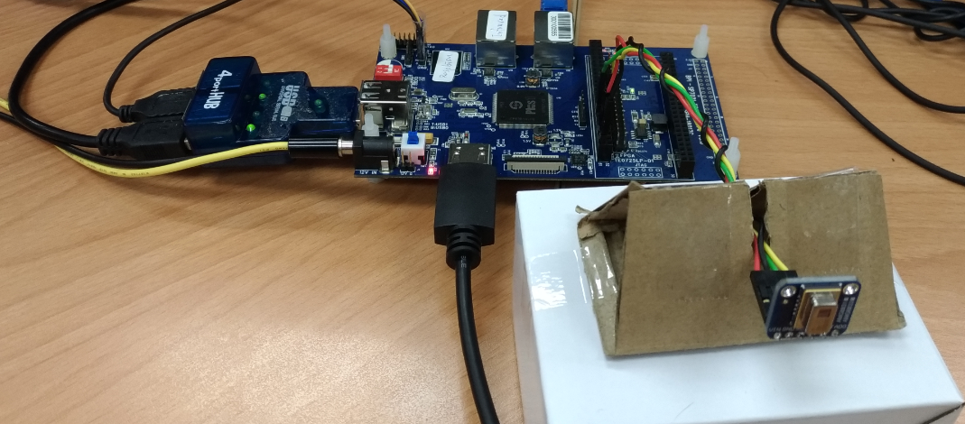
2. Platform 組裝完成圖

Slide 5
3. Model training (Windows PC)
PC work environment setup
Download and run python-3.7.7-amd64.exe to install python
Download and run opencv-4.3.0-vc14_vc15.exe to install opencv
After install python, run “pip3 install tensorflow” to install tensorflow

Slide 6
Collect data
The pictures of different gestures obtained through the SP7021 platform. The default requirement is to store 6 gestures. The gesture pictures stored in the folder a/b/c/d/e/f and the corresponding pictures are list as below:

Slide 7
Folder a: forward action
Folder b: intermediate action
Folder c: backward action
Folder d: idle state (no gesture detected)
Folder e: upward movement
Folder f: upward preparation

Slide 8
Model training
The 6 folders of pictures put together with train.py
Execute “python train.py” in dos command window to train data.
After the training is completed, the model file hand.tflite will be generated.

Slide 9
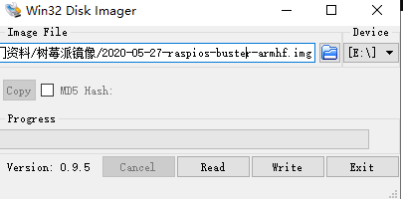
4. SP7021 Platform Environment Setup
Download the latest image file from the Raspberry Pi website and write it into sdcard by Win32DiskImager.
Download path: https://www.raspberrypi.org/downloads/raspberry-pi-os/

Slide 10
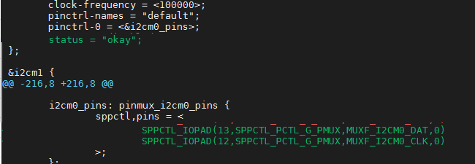
Enable i2c port in sp7021-bpi-f2s.dts of linux source code
Copy the 5 boot files of SP7021 to the boot partition of the sdcard

Slide 11
After SP7021 boot, run “sudo raspi-config --expand-rootfs” to expand rootfs partition
Run “sudo apt install cmake libopencv-dev” to install cmake and opencv

Slide 12
5. Download test code and compile
Download test code from below icon
Compile thermal_cam
Copy and decompressed the thermal_cam.tar.gz from sdcard to work folder
run “make” to compile thermal_cam.cpp
After the compilation is complete, the thermal_cam file will be generated

Slide 13
6. Run thermal_cam
Test mode :run ./themal_cam temp_L temp_H hand.tflite
temp_L：Minimum temperature
temp_H：Maximum temperature
hand.tflite：Model files generated by training on the PC side based on the collected pictures

Slide 14
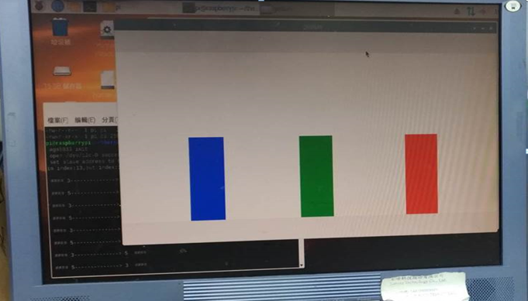
The figure change rule defined as below.
1->0 light to blue bar
0->1 or 2->1 light to green bar
1->2 light to red bar
5->4 bar become higher
4-> 0, 1, 2 bar become lower

Slide 15
Collection mode: run ./themal_cam temp_L temp_H
There have 2 screens been created, ori_image and new_image
ori_image：AMG8833 Get the temperature and convert the corresponding color image
New_image：The image obtained by ori_image after grayscale processing, black and white is convenient for model training and recognition

Slide 16
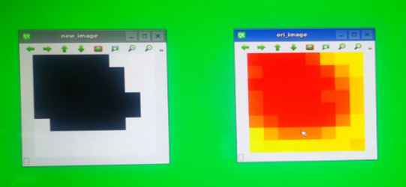

Slide 17
At this time, you can push the 'a','b','c','d','e','f' buttons through the keyboard to save the gesture action images to the corresponding folder. Then copy it to the corresponding directory of the PC environment for data training. (Each input saves 1000 images)
KEY a: forward action
KEY b: intermediate action
KEY c: backward action
KEY d: idle state (no gesture detected)
KEY e: upward movement
KEY f: upward preparation

