Slide 1
SP7021軟體環境教學
Smart Computing Program 2020/8

Slide 2
Outline
SP7021 source code 取得
SP7021 source code 編譯
SP7021 boot on Raspbian
SP7021 boot on ubuntu mate
SP7021 yocto system
訓練與開發環境架設

Slide 3
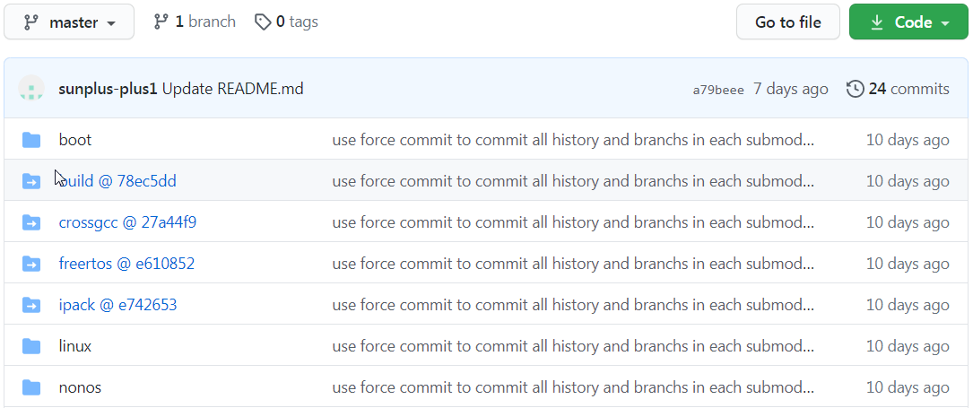
SP7021 source code 取得
到https://github.com/sunplus-plus1/SP7021下載
$ git clone https://github.com/sunplus-plus1/SP7021.git

Slide 4
SP7021 source code 取得
Before you compile, please install some packages for compiling.
$ sudo apt-get install openssl libssl-dev bison flex
Please run following commands to get source code
$ git clone https://github.com/sunplus-plus1/SP7021.git
$ cd SP7021
$ echo "export PATH=\$PATH:"`pwd`/boot/uboot/tools >> ~/.bashrc
$ source ~/.bashrc
$ git submodule update --init --recursive
$ git submodule update --remote --merge
$ git submodule foreach --recursive git checkout master

Slide 5
SP7021 source code 編譯
Make config
$ make config
then show
Select boards:
[1] SP7021 Ev Board [11] I143 Ev Board
[2] LTPP3G2 Board [12] I143 Zebu (zmem)
[3] SP7021 Demo Board (V1/V2)
[4] SP7021 Demo Board (V3)
[5] BPi-F2S Board
[6] BPi-F2P Board

Slide 6
if you select [2] ~ [6],
Select configs.
[1] eMMC
[2] SD Card
after make config is completed. Then
$ make all
to do compile.

Slide 7
please get image file from out folder
eMMC case:
Copy out/ISPBOOOT.BIN in out folder to USB stick (FAT32)
Update USB stick to eMMC -> (Power off, set SW1 to ON, SW2 to OFF, power on)
Boot kernel -> (Power off, set SW1 to OFF, SW2 to OFF, power on)
SD Card case:
get out/boot2linux_SDcard/ISP_SD_BOOOT.img
copy to sdcard -> (sudo dd if=ISP_SD_BOOOT.img of=/dev/sdx bs=1M, /dev/sdx is your sdcard address)
put your sdcard to board and boot -> (Power off, set SW1 to ON, SW2 to ON, power on)

Slide 8
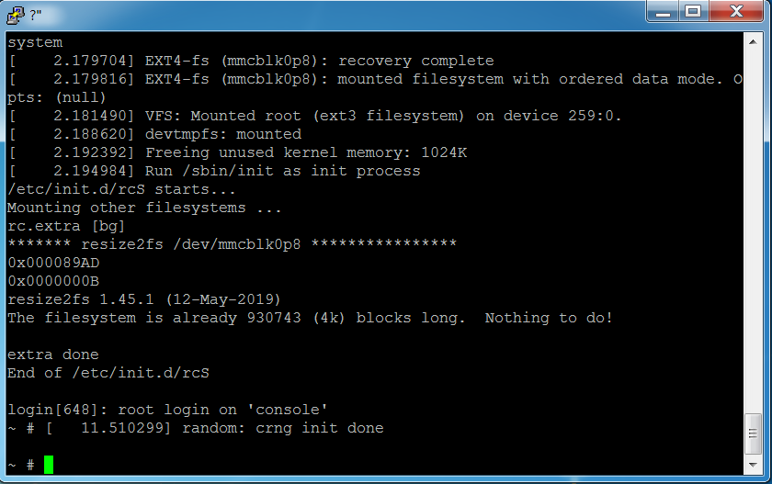
原生的linux command line 介面

Slide 9
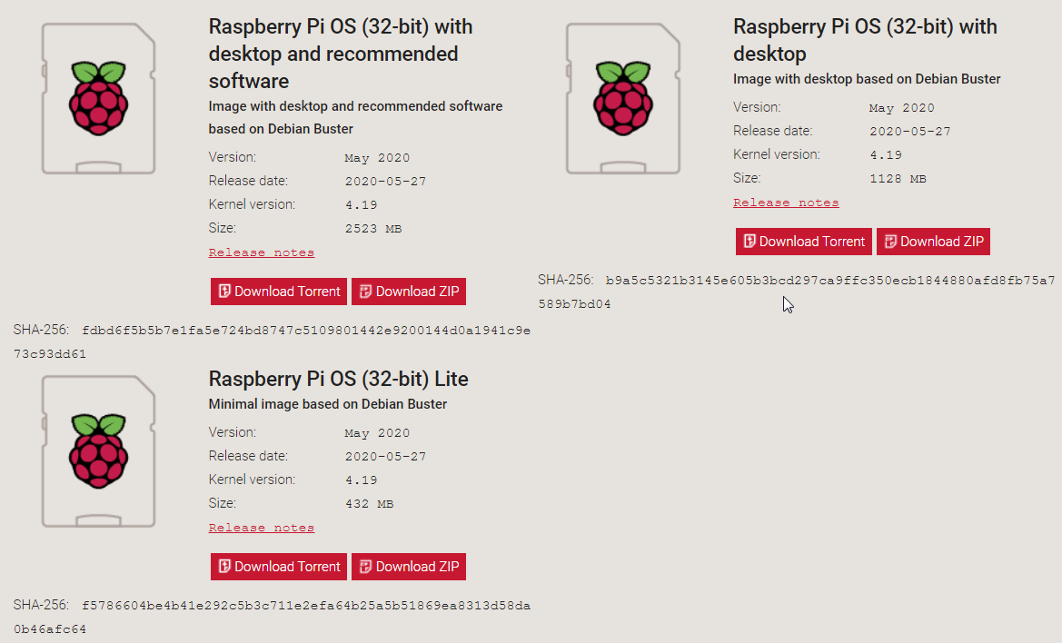
SP7021 boot on Raspbian
到樹莓派官網下載image檔 (2020-05-17-raspios-buster-full-armhf)

Slide 10
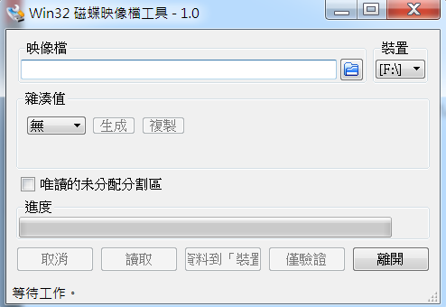
Write image to SD card
Window下請下載Win32DiskImager
Ubuntu下請執行 “sudo dd if=2020-05-27-raspios-buster-full-armhf.img of=/dev/sdb bs=4M”

Slide 11
Compile SP7021 source code for SD card
將make產生出來的檔案 (ISPBOOOT.BIN, u-boot.img, uImage, uEnv.txt, a926.img) 放入樹莓派(SD card)的 boot partition. <註> a926.img (optional image for ARM926)
將make產生出來的驅動程式 放入樹莓派的rootfs partition (/lib/modules)
以SD card當source重新開機

Slide 12
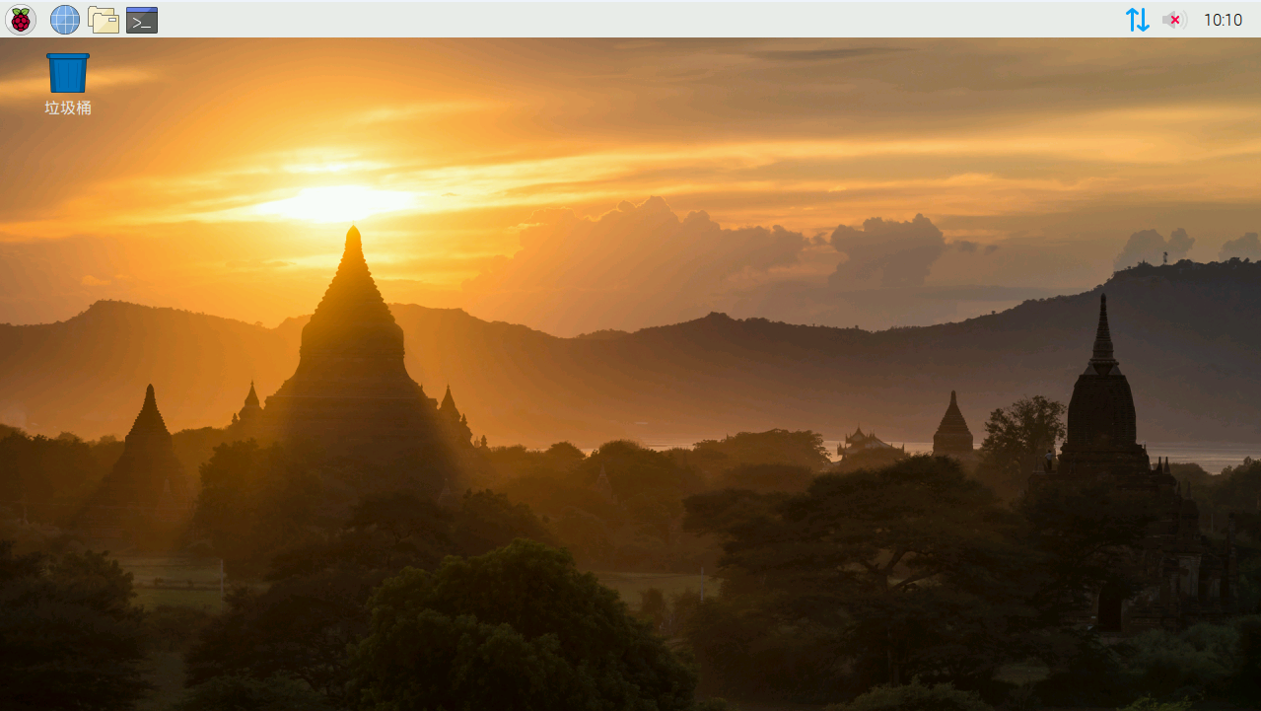

Slide 13
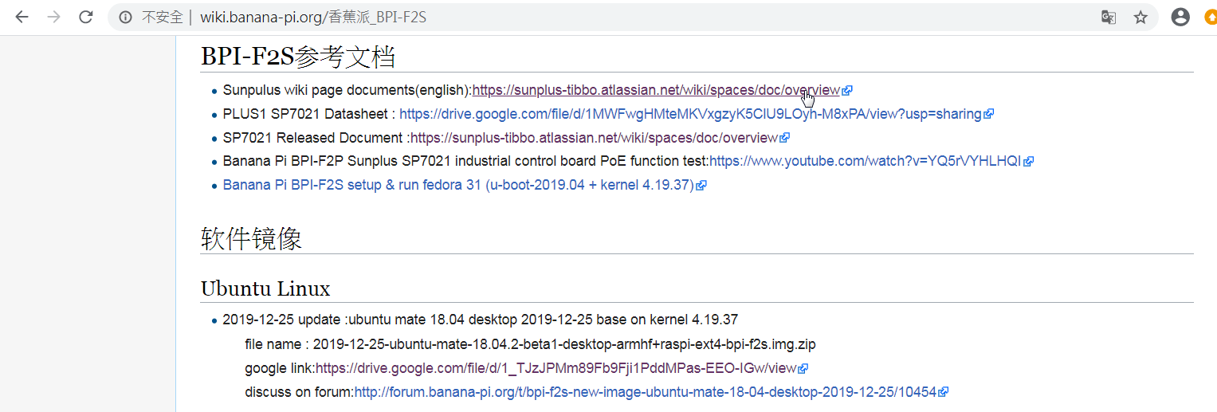
SP7021 boot on ubuntu mate
到http://wiki.banana-pi.org/%E9%A6%99%E8%95%89%E6%B4%BE_BPI-F2S下載image檔

Slide 14
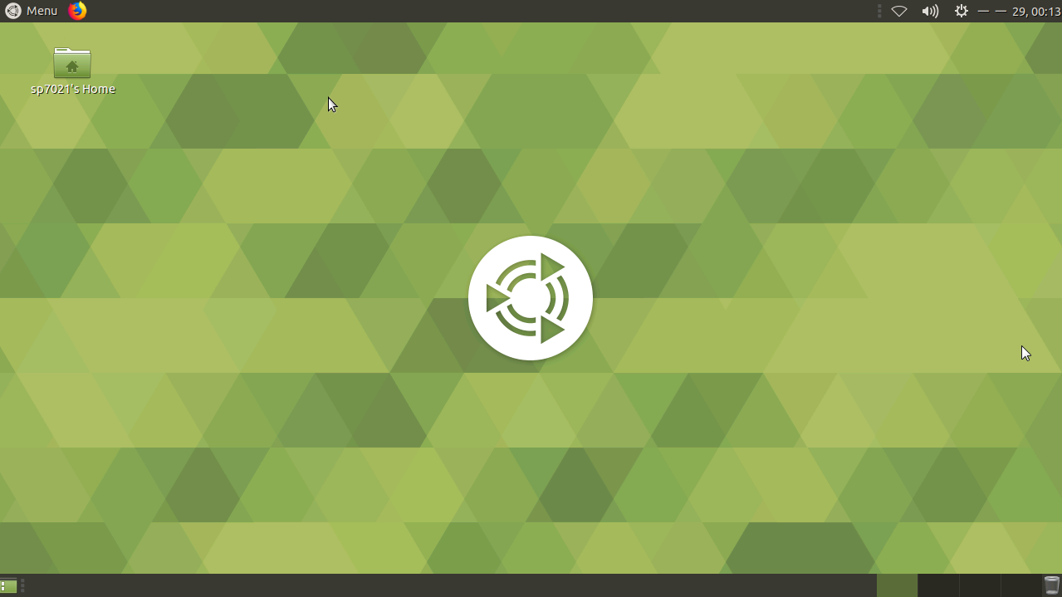

Slide 15
SP7021 yocto system
連線到 https://113.196..136.132 進入yocto compile system
Push “download” icon to get source code
Push “Select develop board” and select correct board type
Push “Boot from” to select boot from emmc or sdcard
Push “Select package groups” to select support functions
Opencv4.2
Python2.7
Python3.7

Slide 16
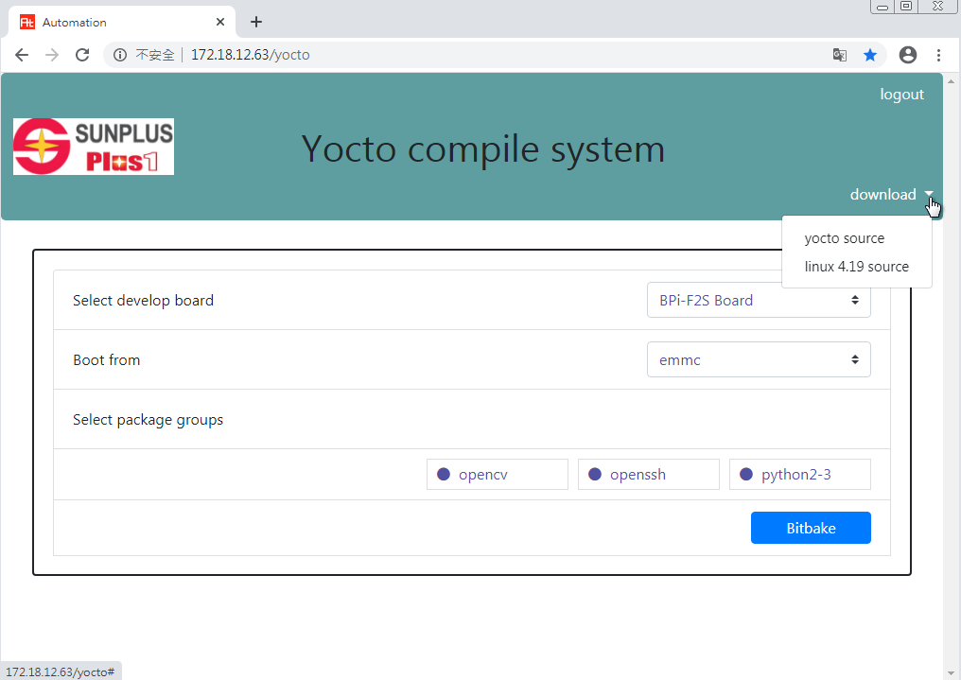

Slide 17
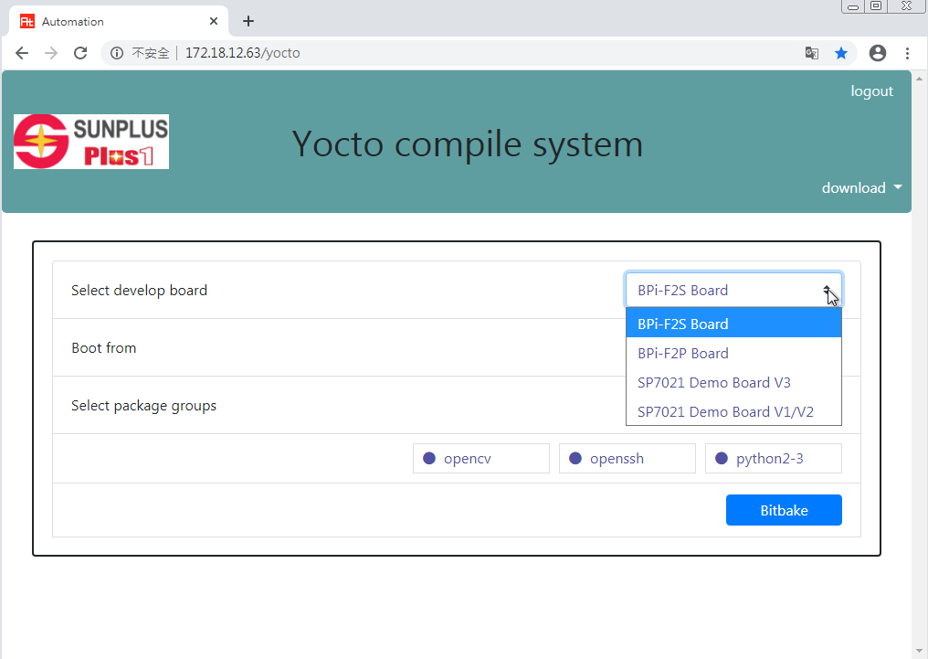

Slide 18
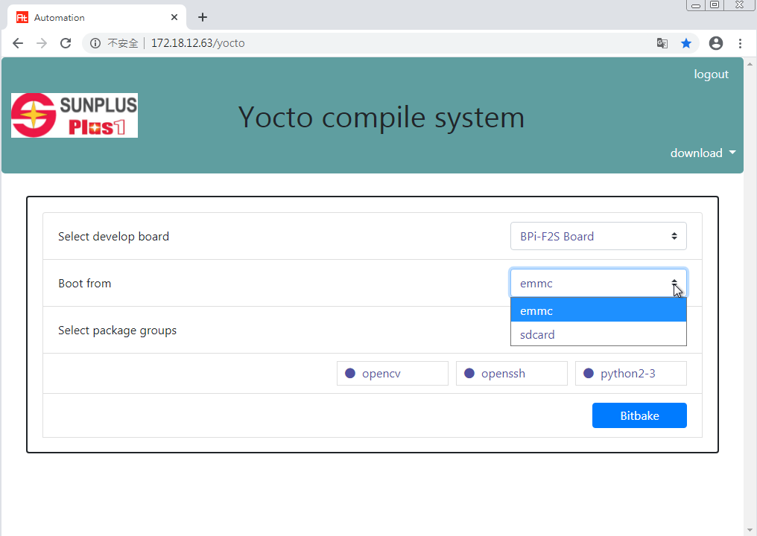

Slide 19
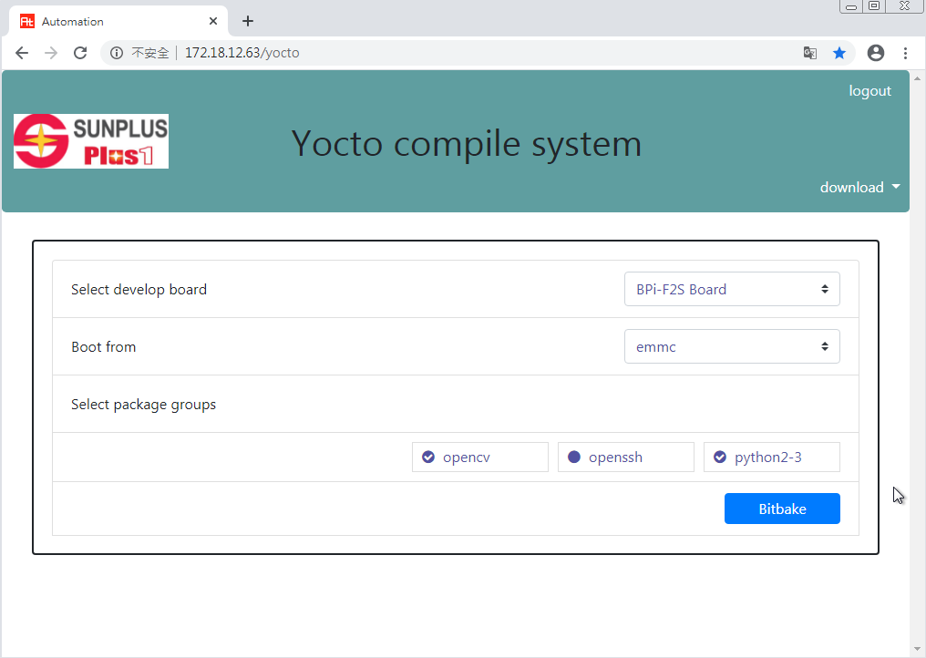

Slide 20
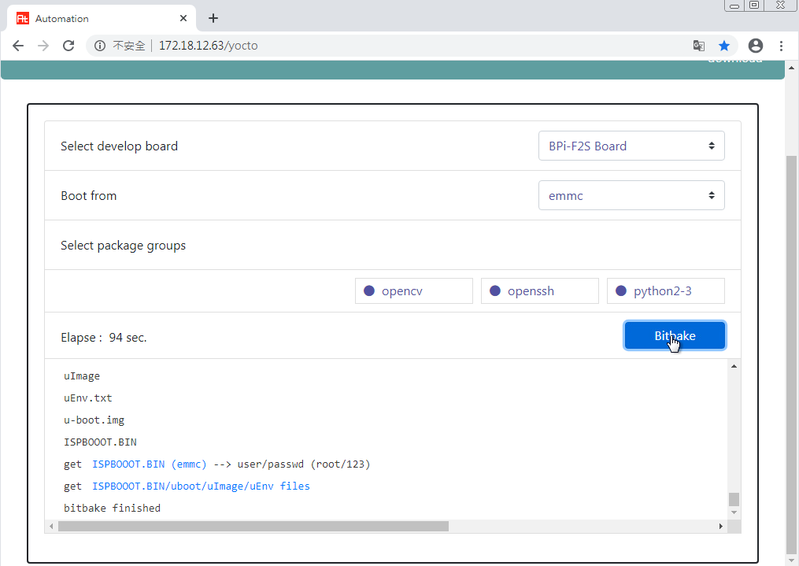

Slide 21
訓練與開發環境架設
System Requirement
Python3.5 ~ 3.7
pip 19.0 or higher
Tensorflow 1.14 or higher
OpenCV 4.1 or higher

Slide 22
訓練環境架設 on win10
Download and run python-3.7.7-amd64.exe to install python
Download and run opencv-4.3.0-vc14_vc15.exe to install opencv
After install python, run "pip3 install tensorflow" to install tensorflow
After the installation complete, execute python->import tensorflow/import cv2 in the dos command window to check whether the installation is correct.

Slide 23
訓練與開發環境架設 on Linux PC (ubuntu18.04 以上)
Ubuntu內建有python2&3
Update pip version to 19
python3 -m pip install --upgrade pip
Install tensorflow versoin to 2.0 (support keras)
pip3 install --user --upgrade tensorflow
Install opencv version to 4.1
sudo apt install pyhton3-opencv

Slide 24
訓練與開發環境架設 on SP7021
將樹莓派安裝到SP7021開發版
樹莓派內建有python2&3
Update pip version to 19
python3 -m pip install --upgrade pip
Install tensorflow versoin to 1.14
pip3 install --user --upgrade tensorflow
Install opencv version to 4.1
sudo apt install pyhton3-opencv
Install keras
Sudo pip3 install keras

